Slide 1
Tri-Institutional Translational and Clinical Research Pilot Program
Pre-submission Webinar
October 28, 2024
New Jersey Alliance for Clinical and Translational Science:
A Platform for Translational Science in New Jersey
http://njacts.rbhs.rutgers.edu An NCATS-funded CTSA Hub: UM1TR004789

Slide 2
Pilot Studies Co-Leads
Arnold Rabson, MD
Laura Gallagher Chair of Developmental Biology and
Director, The Child Health Institute of New Jersey and
Professor of Pharmacology; Pediatrics, and Pathology and Laboratory Medicine;
Rutgers Robert Wood Johnson Medical School
Guiling (Grace) Wang, PhD
Professor
Associate Dean for Research
The Ying Wu College of Computing
New Jersey Institute of Technology
Joseph Jaeger, DrPH, MPH
Associate Vice President, Research
Chief Academic Officer
RWJ Barnabas Health
Samuel Wang, PhD
Professor Princeton Neuroscience Institute
Princeton University

Slide 3
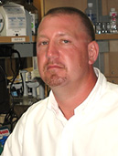
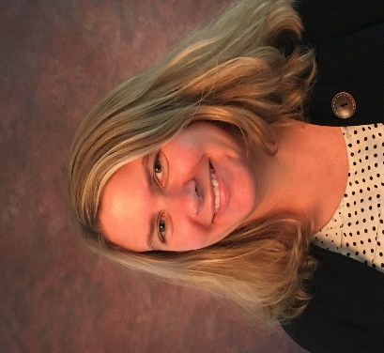
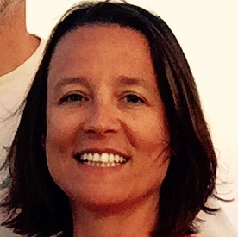
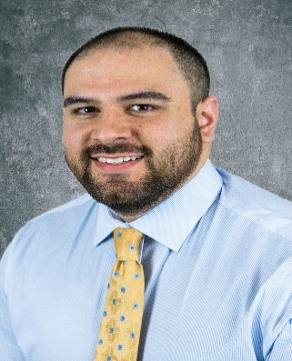
Pilot Program Administrative Staff
William Jester,
Director of Administration
Casandra Burrows,
CTSA Administrator
Judith Argon,
Executive Lead Prog. Dev.
Pam Dahlen,
Financial Assistant
Anthony Gonzales,
Regulatory and Compliance
Bianca Freda
Princeton, Manager, Research
& Admin

Slide 4
Tri-Institutional CTR Pilot Program
Acknowledgement:
This program was made possible by the generous institutional support provided by:
Rutgers: $100,000
Princeton: $100,000
NJIT: $50,000

Slide 5
Aims of the Pilot Program
Enhance, broaden, and bolster research endeavors in translational research
Propel clinical and translational research initiatives across our institutions
Provide financial resources to nurture projects

Slide 6
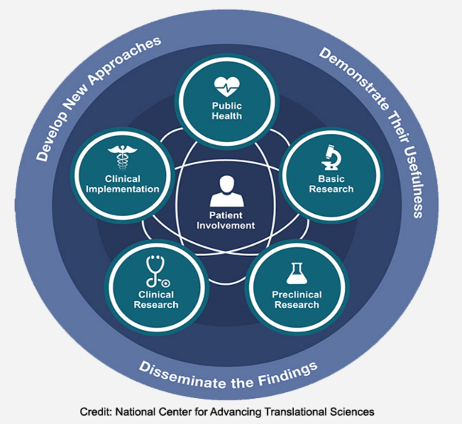
What is Translational Research (v Translational Science)
Translating discoveries from laboratory to bedside to populations

Slide 7
What is Translational Research (v Translational Science)
Translational research is a continuum:
Develop new approaches and the transfer of applying discoveries from basic research
Demonstrate their usefulness through clinical trials and studies
Disseminate the findings to enhance best practices in the community and to impact policy to improve human health.

Slide 8
Important Notes
All pilot proposals must demonstrate clinical relevance
Number of awards is flexible depending on the number and quality of proposals
Collaboration across institutions is encouraged but not required

Slide 9
Application Types
Clinical and Translational Research Projects:
Anywhere along the entire range of the translational research continuum (T0-T4)
Laboratory-based, clinical, health services, epidemiology, community engagement, and diversity research
Projects that focus on novel aspects of the heterogeneity of disease and response to therapy are encouraged.
PROPEL Projects
High-risk, high-reward
Catalyze scientific discovery by supporting proposals to explore novel ideas, adding new technologies or research methods to a project
Enable clinical data acquisition, purchase of small equipment, or licenses to data sets.

Slide 10
Application Types
Valued Partner Projects
Support team research and build liaisons with key partners in industry, government, non-profits, other CTSAs, and/or insurance companies.
Must leverage institutional support with partner in-kind services or funding.
Proposals must include a detailed description of the in-kind support and a letter of support from the partner organization.

Slide 11
Budget and Project Length
Proposals from Princeton and Rutgers may request between $50,000 and $100,000; NJIT proposals may request $50,000. Collaborative proposals between institutions may request no more than $100,000.
Awarded budget may be reduced based on the number of highly meritorious proposals.
Project Duration: 12 months
Start-date:
Depends on regulatory review/approval requirement
One no cost extension will be allowed for this program with sufficient justification

Slide 12
PI/Co-PI Eligibility
Be well suited to the project
Can devote sufficient effort to complete the proposed aims
Appropriate experience and training to lead this project
Demonstrated an ongoing record of accomplishments in their field(s).
If the project is collaborative or multi-PD/PI, the investigators should have complementary and integrated expertise
PI(s) must:
Have a primary affiliation with the sponsoring institutions (Rutgers, Princeton, and NJIT)
Hold a faculty or equivalent position
RWJ Barnabas Health investigators may serve as Co-I’s
Postdoctoral fellows, residents, and clinical fellows may serve as Co-I’s, provided their mentors are from one of the three sponsoring institutions.
PIs/Co-PIs are limited to one application per cycle.
The sole exception is clinicians who may have a specific expertise or patient populations that maybe relevant to more than one proposal. Eligibility for this exception should be clearly described in both the LOI and the application.

Slide 13
Application Process: Letter of Intent
Required
Due November 4, 2024 (by midnight)
LOI Form available at: https://redcap.rwjms.rutgers.edu/surveys/?s=RKJ9HNWX9M34CFAR
REDCap Form: Title, Co-PIs, Draft Abstract, and Draft Specific Aims
Purpose:
Ensure match between RFA and project
Specifically ensure responsiveness as Translational Science and not Translational Research
Assess competitiveness
Allow leaders to start matching reviewers to projects
Institutional sign-off: Not required for LOI
Notification by November 8th if deemed eligible or not
Applicants receives a link to begin application process

Slide 14
Application Components
Program Specific Form: REDCap link is sent to each applicant
Abstract: up to ½ page
Specific Aims: up to ½ page
Research Strategy: up to 5 pages
Background/Preliminary Data (2 pages)
Research Plan (3 pages)
Objective
Approach
Milestones
Deliverables
Anticipated Impact
How will the project lead to independent funding: up to 1 page
Project Timeline by Month: up to 1 page

Slide 15
Application Components, cont.
References
Other Support Information for Co-Pis
Detailed Budget
NIH Biosketch for Co-PIs and Key Personnel
Letters of Support

Slide 16
Application Review Process
Due: December 13th 2024 (5:00 pm)
Levels of Review:
Administrative Review
Initial Review:
Reviewers selected from:
Academy of Mentors
Previous pilot awardees
Prominent scientists in the field
Review by the Primary Review Committee
Final review and funding decision will be made by the Executive Committee of Co-Leads from the Alliance partners

Slide 17
Review Criteria
Impact
Use of NJ ACTS resources
Collaboration-building potential
Potential to generate reproducible findings and high-quality
Excellence of the science
Potential for translation
Likelihood of success
Use of RWJBH data, facilities or patients (requires RWJBH sign-off)
Potential for:
Publications
NIH funding
Adoption of outcomes by health system

Slide 18
Application Process: Due December 13th
 | Page Limits
Clinical and Translational Research Pilot Application Form | REDCap Form
Additional elements to be submitted as a single PDF in this order:
Research Strategy | 6 pages
Project Abstract | Up to ½ page
Specific Aims (note: abstract/specific aims should equal 1 page) | Up to ½ page
Background/Preliminary Data | Up to 2 pages
Research Plans | Up to 3 pages
How will Pilot Program funding lead to independent or sustainable funding? | Up to 1 page
Project Timeline by month | Up to 1 page
References | As needed
Other Support Information for Co-PIs (NIH Format) | As needed
Detailed Budget (NIH PHS 398): 1 for each participating institution and Budget Justification (1 for each participating institution), plus cumulative Budget | As needed for each PI/Institution
Co-PI’s NIH-formatted biosketch | Up to 5 pages
Key personnel NIH formatted biosketches | Up to 5 pages each
Letters of support from affiliates, partners, or others | Up to 1 page each

Slide 19
Institutional Sign-off
LOI:
Not required for LOI
Application:
Depends on institutional requirements
See RFA for details
If collaborating across NJ ACTS affiliates or other entities, a separate budget and sign off is required

Slide 20
When Will We Hear? How Soon Can We Start?
Award Notification: February 2024
Actual Start Date and Release of Funds Depend On:
Not involving human subjects or vertebrate animals or foreign components:
As soon as any modifications required by the committee are received
Involving human subjects or vertebrate animals or foreign components:
Institutional regulatory approvals required (animals/humans)
Anticipated date: March 2025

Slide 21
How Long is the Project?
Project Period
12 months
Are No Cost Extensions Allowed?
1 NCE is allowed
Justification is required

Slide 22
Where do we go for help?
Does my project fit the RFA:
Pilots Co-leads
Identifying potential Co-PIs
RFA contains a helpful list
Budgets, Subcontracts, Approvals
Email: njacts@rbhs.rutgers.edu

Slide 23
Q&A

